Slide 1
OW EE.UU.

Slide 2
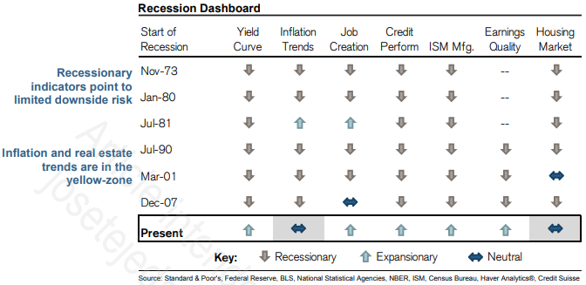
OW EE.UU.
Credit Suisse

Slide 3
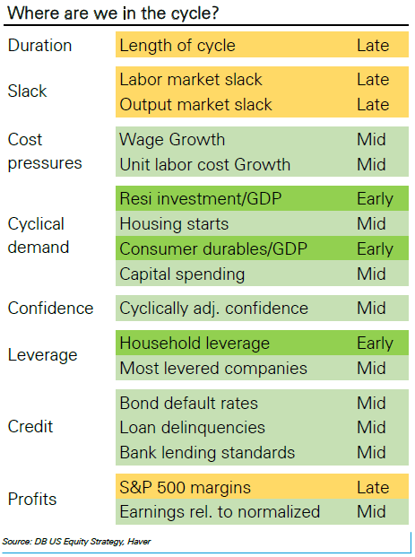
OW EE.UU.
Deutsche Bank

Slide 4
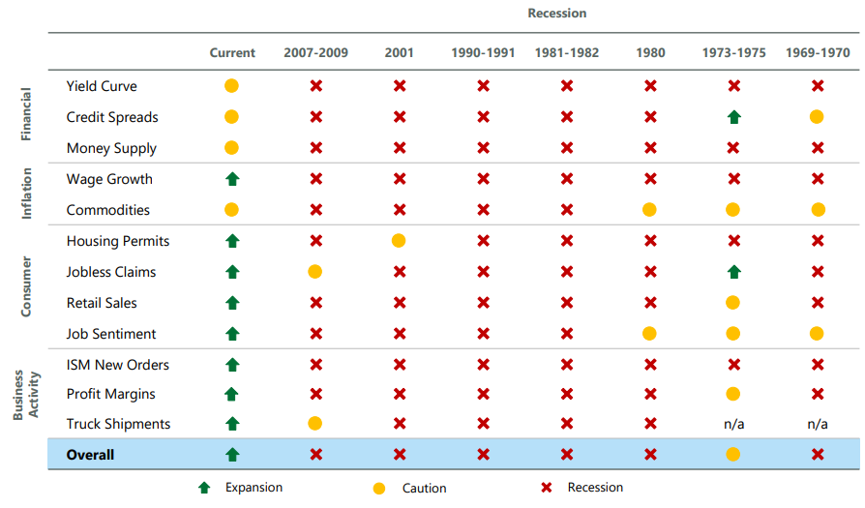
OW EE.UU.
Legg Masson / ClearBridge

Slide 5
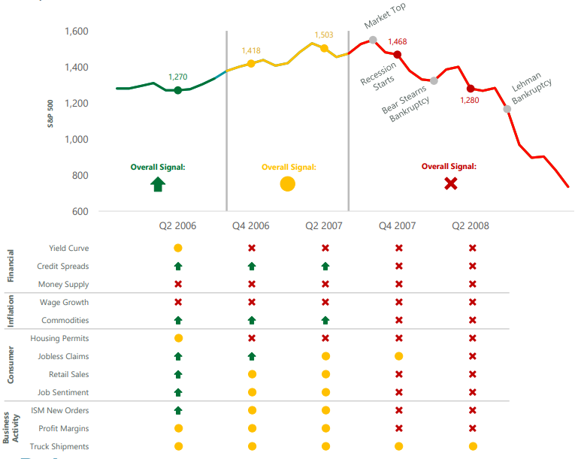
OW EE.UU.
Legg Masson / ClearBridge

Slide 6
OW EE.UU.
Deutsche Bank
Mid Cycle
Economic recovery is robust
Plenty of slack in the labor market
S&P 500 rose annualized 10%
Late Cycle
Growth is still robust
Labor market has tightened and unemployment fallen below the natural rate
S&P 500 rose annualized 17%
End Cycle
Index of leading indicators start to fall sharply going into recession and continuing until the equity market bottoms
S&P 500 fell annualized -33%

Slide 7
OW EE.UU.
Deutsche Bank
Mid Cycle Basket
Quality growth at cheap valuations
Good at growing and converting earnings into free cash flow
Dash to trash abates
Late Cycle Basket
Quality companies cheap on cash Flow
Growth is still strong but cost pressures and risks are rising
There is a premium for prudence as investors start worrying about a potential en of the cycle
End Cycle Basket
Emphasis shifts sharply to safety and quality
Companies with low volatility, low beta, high cash Flow yields and high return on assets outperform

Slide 8
OW EE.UU.
Deutsche Bank
 |  | Phase
 |  | Early Cycle | Mid Cycle | Late Cycle | End Cycle
Basket | Early Cycle | 44,5% | -2,1% | -6,8% | -21,8%
 | Mid Cycle | 11,9% | 12,4% | 10,9% | 11,6%
 | Late Cycle | -18,9% | 7,9% | 12,4% | 4,7%
 | End Cycle | -19,0% | 5,3% | 4,7% | 39,8%

Slide 9
OW EE.UU.
Fed Model
ISM
ISM Phase | S&P 500 Average Monthly Return | GDP Growth
Trough to 50 | 1,6% | 3,9%
50 to peak | 1,2% | 2,6%
Peak to 50 | 0,8% | 2,6%
50 to trough | -0,4% | -1,3%
Niveles Relevantes

